Slide 1

Let Him Cook!
Learn to Cook smarter with the LHC
Assistant Application.

Slide 2
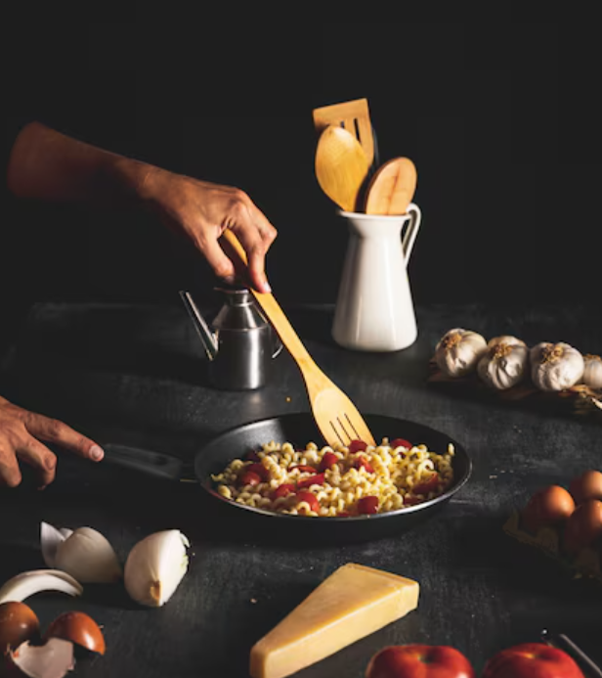
Our Product
1
Bridge the gap between ‘Cooking and Complicated’.
A unique way to learn cooking and get personalized feedback.
2
Continue learning through an incentive and rewards system.
3

Slide 3
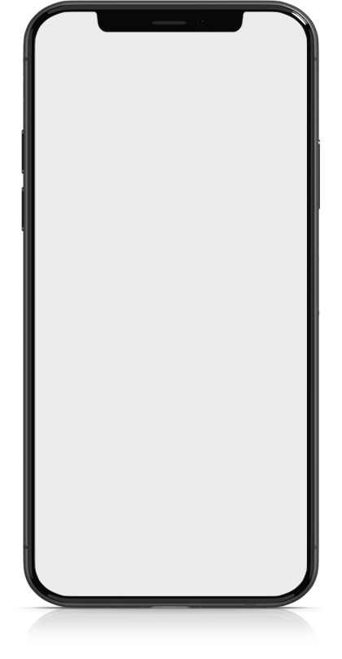


Our Application
1 in 5
Built as a REACT Web App with mobile capabilities.
COLLEGE STUDENTS
College Students don’t
know how to cook.
45%
REACT
25%
95%
MongoDB + Neurelo
20%
EMERGING TECH (AI)
95% of people want to engage
in a points-based loyalty
program using emerging
technologies like AI.
Google AI Studio
10%
Other

Slide 4
Time for a DEMO!
It is time to see our application work fully in function.

Slide 5



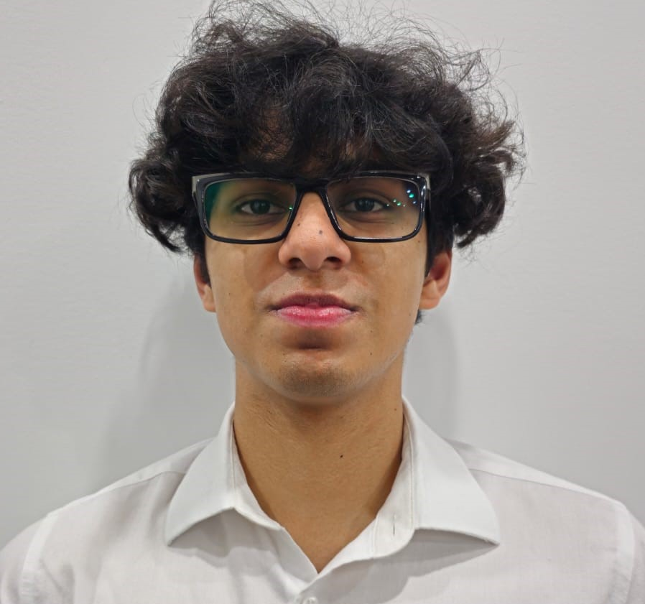
Thank You!
We are happy to answer any questions and take feedback ☺.
Matthew Frieri
Naresh Godwin
Sehaj Lally
Masood Ashrafi

